Slide 1

6th Grade Math
Unit 8, Lesson 10 Surface Area of Rectangular Prisms Volume 2, pg. 124

Slide 2


Benchmark
MA.6.GR.2.4
Given a mathematical or real-world context, find the surface area of right rectangular prisms and right rectangular pyramids using the figure’s net.
volume 2, pg. 124

Slide 3
Integrated Mathematical Thinking and Reasoning Standards
MA.K12.MTR.1.1 Actively participate in effortful learning both individually and collectively.
MA.K12.MTR.2.1 Demonstrate understanding by representing problems in multiple ways.
MA.K12.MTR.4.1 Engage in discussions that reflect on the mathematical thinking of self and others.
MA.K12.MTR.5.1 Use patterns and structure to help understand and connect mathematical concepts.
MA.K12.MTR.7.1 Apply mathematics to real-world contexts.
volume 2, pg. 124

Slide 4

Learning Target
I can find the surface area of a rectangular prism using a net or the figure.
volume 2, pg. 124

Slide 5

Warm-Up
volume 2, pg. 124

Slide 6
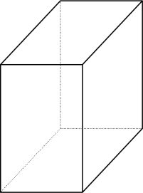
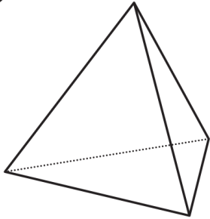
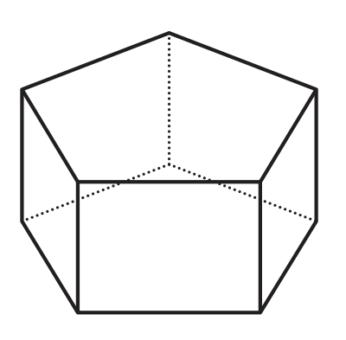

8.10.1 Warm-Up: Which One Doesn’t Belong?
Four figures are shown.
A | B
C | D
volume 2, pg. 124

Slide 7
Which one doesn’t belong?
Justify your choice using mathematics.
volume 2, pg. 124

Slide 8

Guided Instruction
volume 2, pg. 125

Slide 9
8.10.2 Guided Instruction: Surface Area of a Rectangular Prism
To find the surface area of a three-dimensional object, use the nets of a shape to find the area of each face.
Surface area is the total area of the two-dimensional surfaces that make up a three-dimensional object
volume 2, pg. 125

Slide 10
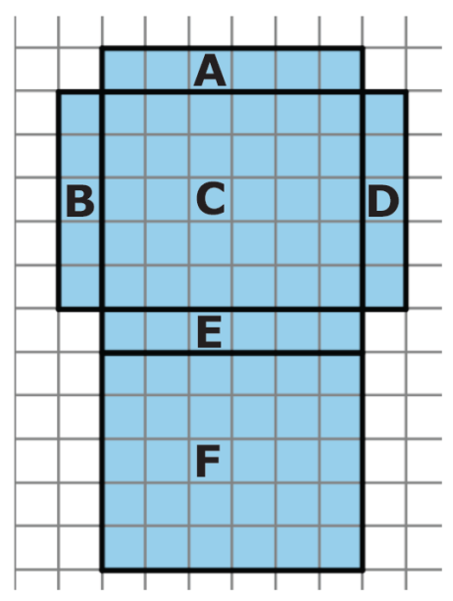
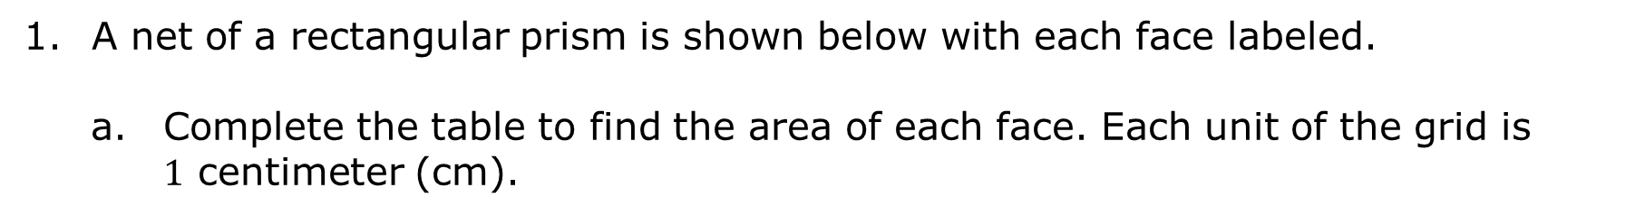
A net of a rectangular prism is shown below with each face labeled.
Complete the table to find the area of each face. Each unit of the grid is $1$ centimeter (cm).
Face | Dimensions | Area
A
B
C
D
E
F
volume 2, pg. 125

Slide 11

How can the net and the area of the six faces be used to find the surface area of the prism?
What is the surface area of this rectangular prism?
When calculating surface area, find the sum of the areas of each face of the figure. Use the figure’s net to label the dimensions needed to calculate the area of each face.
volume 2, pg. 125

Slide 12

A tissue box is $9$ inches (in.) long, $5$ in. wide, and $6$ in. tall.
Sketch the net of the tissue box.
volume 2, pg. 126

Slide 13
Label the dimensions of each face on the net.
Find the area of each face. Include units.
Add the area of the faces to find the surface area of the tissue box. Include units.
volume 2, pg. 126

Slide 14

Guided Practice
volume 2, pg. 127

Slide 15

8.10.3 Guided Practice: Surface Area of a Rectangular Prism
Gretchen is preparing to paint a jewelry box but does not know how much paint she needs to buy.
What information about the jewelry box does Gretchen need to know in order to buy paint?
volume 2, pg. 127

Slide 16
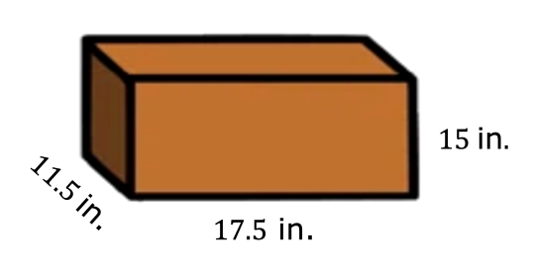
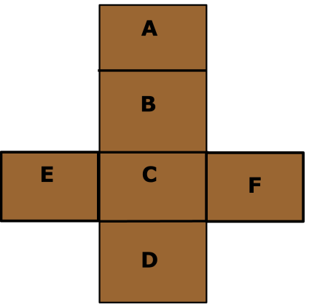
Gretchen measured the box to be $17.5$ inches (in.) long, $11.5$ in. wide, and $15$ in. tall.
The net of the jewelry box is shown. Label the side lengths of the net. Record the dimensions in the table.
volume 2, pg. 127

Slide 17
Face | Dimensions | Area
A
B
C
D
E
F
What is the surface area of the box that Gretchen needs to buy paint for? Include units.
volume 2, pg. 127

Slide 18
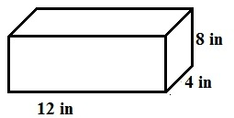

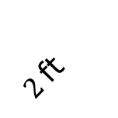

Jillian and Victor are finding the surface area, in square feet (ft²), of the rectangular prism shown and each got the same answer; however, they solved the problem differently.
$1.5$ft
$2$ft
$5.5$ ft
volume 2, pg. 128

Slide 19
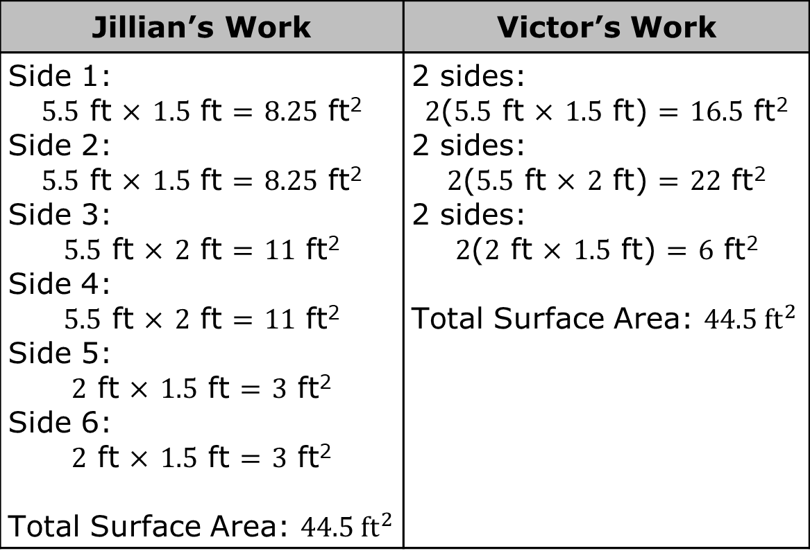
Jillian’s Work | Victor’s Work
Side 1: $5.5$ ft $×$ $1.5$ ft $=$ $8.25$ ft² Side 2: $5.5$ ft $×$ $1.5$ ft $=$ $8.25$ ft² Side 3: $5.5$ ft $×$ $2$ ft $=$ $11$ ft² Side 4: $5.5$ ft $×$ $2$ ft $=$ $11$ ft² Side 5: $2$ ft $×$ $1.5$ ft $=$ $3$ ft² Side 6: $2$ ft $×$ $1.5$ ft $=$ $3$ ft² Total Surface Area: $44.5 {\text{ft}}^{2}$ | 2 sides: $2$($5.5$ ft $×$ $1.5$ ft) $=$ $16.5$ ft² 2 sides: $2$($5.5$ ft $×$ $2$ ft) $=$ $22$ ft² 2 sides: $2$($2$ ft $×$ $1.5$ ft) $=$ $6$ ft² Total Surface Area: $44.5 {ft}^{2}$
Discuss with your partner each student’s strategy and how they are similar or different. Draw arrows to show connections between each student’s work.
volume 2, pg. 128

Slide 20

Your Turn
volume 2, pg. 129

Slide 21



8.10.4 Your Turn!
Darsey wants to build trinket boxes made of wood to sell at the local craft festival. A drawing of her box is shown. How much wood does Darsey need to buy for each trinket box?
$8$in.
$5$in.
$10$in.
volume 2, pg. 129

Slide 22
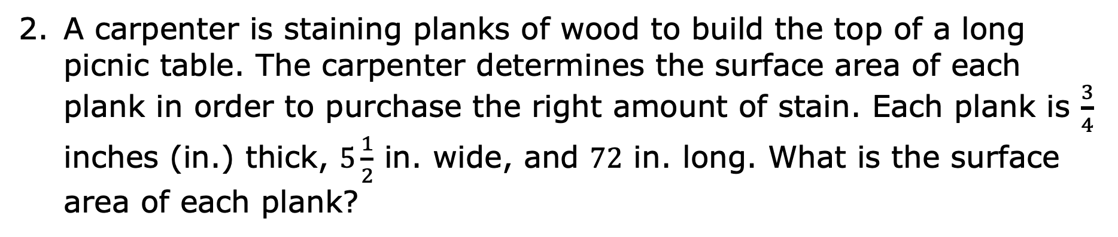
A carpenter is staining planks of wood to build the top of a long picnic table. The carpenter determines the surface area of each plank in order to purchase the right amount of stain. Each plank is $\frac{3}{4}$ inches (in.) thick, $5\frac{1}{2}$ in. wide, and $72$ in. long. What is the surface area of each plank?
volume 2, pg. 129

Slide 23

Wrap-Up
volume 2, pg. 130

Slide 24
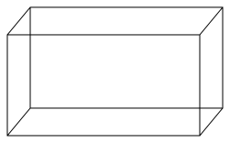



8.10.5 Wrap-Up: Ticket Out the Door
Ted is preparing a holiday display for the post office. He takes an unfolded box and uses it to determine the amount of wrapping paper needed to wrap the box.
The shipping box Ted uses for the display is shown.
$4.8$in.
$4.5$in.
$12$in.
volume 2, pg. 130

Slide 25
Write the measurements on the net of the box.
Use the net to find the surface area of the shipping box. Include units.
volume 2, pg. 130

